Slide 1
Ethics in Information Technology, Fourth Edition
Chapter 8
The Impact of Information Technology on Productivity and Quality of Life

Slide 2
Objectives
As you read this chapter, consider the following questions:
  What impact has IT had on the standard of living and worker productivity?
  What is being done to reduce the negative influence of the digital divide?
  What impact can IT have on improving the quality of healthcare and reducing its costs?
Ethics in Information Technology, Fourth Edition

Slide 3
Objectives (cont’d.)
What ethical issues are raised because some entities can afford to make significant investments in IT while others cannot and thus are blocked in their efforts to raise productivity and quality?
Ethics in Information Technology, Fourth Edition

Slide 4
The Impact of IT on the Standard of Living and Worker Productivity
Gross domestic product (GDP)
  Measurement of the material standard of living
  Equals total annual output of a nation’s economy
Standard of developed countries
  Has improved for a long time
  Rate of change varies as a result of business cycles
Productivity
  Amount of output produced per unit of input
  A measure of the efficiency of a person, machine, factory, system, etc., in converting inputs into useful outputs
Ethics in Information Technology, Fourth Edition

Slide 5
IT Investment and Productivity
Factors that affect national productivity rates
  Business cycles of expansion and contraction
  An expansion is characterized by increasing employment, economic growth, and upward pressure on prices. A peak is the highest point of the business cycle, when the economy is producing at maximum allowable output, employment is at or above full employment, and inflationary pressures on prices are evident. Following a peak, the economy typically enters into a correction which is characterized by a contraction where growth slows, employment declines (unemployment increases), and pricing pressures subside.
  Regulations make it easier to hire and fire workers
  More competitive markets for goods and services
  Difficult to measure output of some services
  IT investments don’t always yield tangible results(services)
  Instead of that they can produce intangible results like quality, services or reliability.
Ethics in Information Technology, Fourth Edition

Slide 6
IT Investment and Productivity (cont’d.)
Telework/Telecommuting
  Employee works away from the office
  Advances in technology enable communications
  Highly skilled workers demand more flexibility
  Organizations must prepare guidelines and policies
  Some positions are not suited to telework(management position)
  Some individuals are not suited to be teleworkers
  Example vmware,IBM,WIPRO
Ethics in Information Technology, Fourth Edition

Slide 7
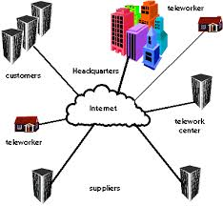
Ethics in Information Technology, Fourth Edition

Slide 8
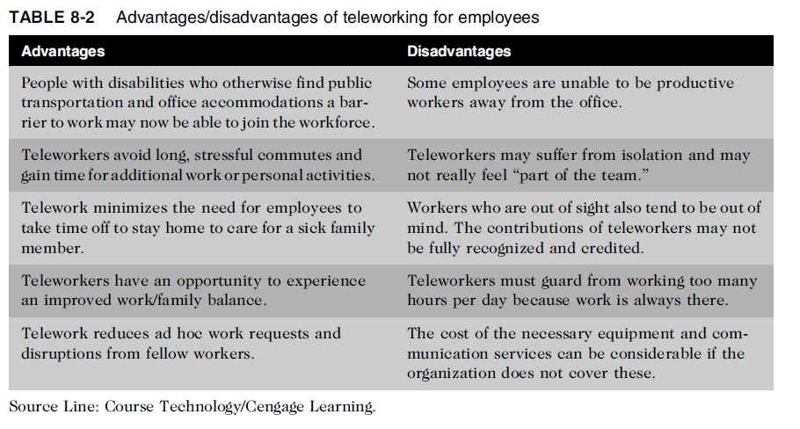
Ethics in Information Technology, Fourth Edition

Slide 9
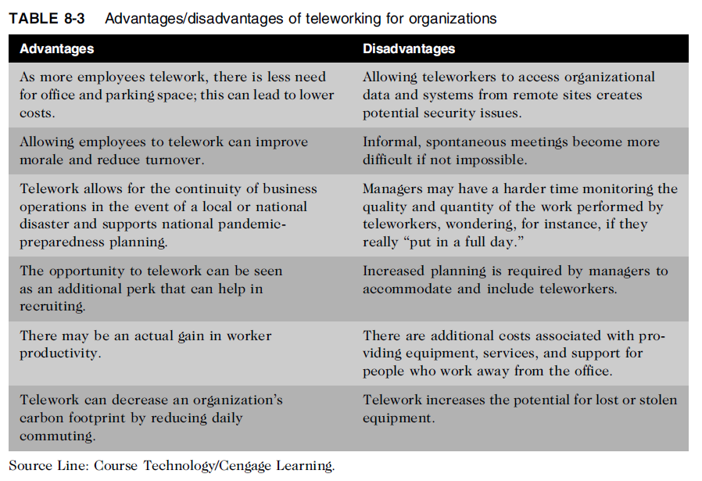
IT Investment and Productivity (cont’d.)
Ethics in Information Technology, Fourth Edition

Slide 10
The Digital Divide
Standard of living
  Level of material comfort measured by the goods, services, and luxuries available
  Example:
  Avg no. of calories consumed by person per day
  Crime rate
  Availability of clean drinking water
Digital divide
  Gulf between those who do/don’t have access to:
    Cell phones
    Personal computers
    The Internet
    In india 20percent of urban Indians and only 2 percent of rural Indians are connected to the Internet.

Slide 11
The Digital Divide (cont’d.)
Digital divide must be bridged to improve resolution of:
  Health emergencies
  Crime emergencies
  Other emergencies
Access to IT and communications technology:
  Enhances learning
  Provides educational and economic opportunities
  Influences cultural, social, and political conditions
Ethics in Information Technology, Fourth Edition

Slide 12
The Digital Divide (cont’d.)
Education Rate (E-Rate) program
  Created by the Telecommunications Act of 1996
  Goal to help schools and libraries obtain:
    Access to state-of-the-art services and technologies
    Discounted rates
Ethics in Information Technology, Fourth Edition

Slide 13
The Digital Divide (cont’d.)
Low-cost computers for developing countries
  One Laptop per Child (OLPC)
    Provides low-cost laptop computers for education
  Classmate PC from Intel
  Eee notebook from Asus
  Aakash laptop(Kapil Sibel)
Mobile phone
  Tool to bridge the digital divide
  Costs less than PC and more broadly available
Ethics in Information Technology, Fourth Edition

Slide 14
The Impact of IT on Healthcare Costs
Increase (above inflation) due to new medical technology
  Diagnostic procedures and treatments
  Patients sometimes overuse medical resources
Patient awareness must be raised
Technology costs must be managed
Improved use of IT can lead to cost reductions
Ethics in Information Technology, Fourth Edition

Slide 15
Electronic Health Records
Electronic health record (EHR)
  Computer readable record of health-related information on an individual: medical history, family history, immunization records, lab data, health problems, progress notes, medications, vital signs, and radiology reports
  Summary of health information generated by each patient encounter in any healthcare delivery setting
  Effective use of EHR improves patient care and reduces costs
Ethics in Information Technology, Fourth Edition

Slide 16
Electronic Health Records (cont’d.)
Lack of patient data transparency results in:
  Diagnostic and medication errors
  Ordering of duplicate tests
  Compromise of patient safety
  At least 98,000 people die in hospitals each year due to preventable medical mistakes
  The HITECH (Health Information Technology for Economic and Clinical Health) Act of 2009 is legislation that was created to encourage the adoption of electronic health records (EHR)
Ethics in Information Technology, Fourth Edition

Slide 17
Use of Mobile and Wireless Technology in the Healthcare Industry
Healthcare industry is a leader in adopting mobile and wireless technology
  Means to access/update EHR at bedsides
  Scan barcodes to match patient with medications
  Communicate with healthcare employees
Ethics in Information Technology, Fourth Edition

Slide 18
Telemedicine
Employs modern telecommunications and information technologies
Provides medical care to people who live far away from healthcare providers
Store-and-forward telemedicine
  Acquires data, sound, images, and video from patient and transmits to medical specialist for evaluation at a later time
  Does not require presence of patient
Ethics in Information Technology, Fourth Edition

Slide 19
Telemedicine (cont’d.)
Live telemedicine
  Requires the presence of patient and healthcare provider at the same time
  Involves a video conference link between the two sites
  Remote monitoring (also called home monitoring)
Monitoring programs can collect a wide range of health data from the point of care, such as vital signs, weight, blood pressure, blood sugar, blood oxygen levels, heart rate, and electrocardiograms.
This data is then transmitted to health professionals in facilities such as monitoring centers in primary care settings, hospitals and intensive care units, skilled nursing facilities, and centralized off-site case management programs. Health professionals monitor these patients remotely and act on the information received as part of the treatment plan.
http://www.cchpca.org/what-is-telehealth/video-conferencing

Slide 20
Telemedicine (cont’d.)
Use of telemedicine raises new ethical issues:
  Must physicians providing advice to patients at remote location be licensed at that location?
  Must healthcare system be required to possess a license from a state in which it has a virtual facility?
  Must minimum set of technology standards be met?
  What sort of system certification and verification is necessary?
  Does patient involvement with remote doctors have negative impact on the local doctor’s relationship?
Ethics in Information Technology, Fourth Edition

Slide 21
Medical Information Web Sites for Laypeople
People need reliable information on a wide range of medical topics to:
  Learn more about healthcare services
  Take more responsibility for their health
Web sites are not substitutes for professional medical advice, diagnosis, or treatment
Some healthcare providers and employers offer online tools that go beyond basic health information
Ethics in Information Technology, Fourth Edition

Slide 22
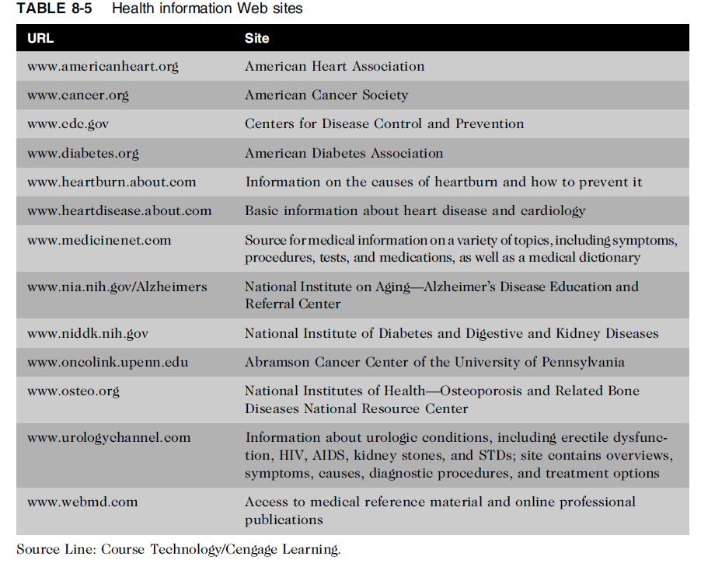
Ethics in Information Technology, Fourth Edition

Slide 23
examples
https://www.intechnic.com/blog/12-best-hospital-and-healthcare-websites/
https://www.practo.com/
https://www.tccrocks.com/blog/top-smartphone-health-apps/
Ethics in Information Technology, Fourth Edition

Slide 24
Summary
Gross national product (GNP) measures material standard of living
Progressive management uses IT to innovate products, processes, and services
Telework opportunities can be used to:
  Reduce costs
  Increase productivity
  Reduce organization’s carbon footprint
  Prepare for potential local or widespread disasters
Ethics in Information Technology, Fourth Edition

Slide 25
Summary (cont’d.)
The digital divide exists:
  Between more and less developed countries
  Within countries, among:
    Age groups
    Economic classes
    People who live in cities versus those in rural areas
New information technologies can be used with little capital cost to reduce the digital divide
Ethics in Information Technology, Fourth Edition

Slide 26
Summary (cont’d.)
Healthcare costs are soaring out of control
  6.3% annual growth rate
  Will reach $4.6 trillion by 2019
Improved use of IT in the healthcare industry can lead to significantly reduced costs
  Electronic health records (EHRs)
  Telemedicine
  Web-based health information
Ethics in Information Technology, Fourth Edition

Slide 27
Mcq’s
____ requires the presence of patients and healthcare providers at different sites at the same time and often involve video conference link between the two sites.
a. Productivity
b. Telework
c. Live Telemedicine
d. Digital divide
Ethics in Information Technology, Fourth Edition

Slide 28
___ employs modern telecommunications and information technologies to provide medical care to people who live far away for healthcare providers
a. Store and Forward telemedicine
b. Telemedicine
c. EHR
d. None of the above
_____ is the term used to describe the gulf between those who do and those who don’t have access to modern communication technologies
a. Productivity
b. Telework
c. Live Telemedicine
d. Digital divide
Ethics in Information Technology, Fourth Edition

Slide 29

Ethics in Information Technology, Fourth Edition

